Slide 1
STEM CELLS (SC)
Stem cells are defined as cells that have clonogenic and self-renewing capabilities and differentiate into multiple cell lineages. Stem cells are found in all of us, from the early stages of human development to the end of life. Stem cells are basic cells of all multicellular organisms.
SC has the potency to differentiate into wide range of adult cells
1. Self renewal and Pluripotency potency are characteristic of stem cell. Though totipotency is shown by very early embryonic stem cells, the adult stem cells possess multipotency and differential plasticity which can be exploited for future generation of therapeutic options.
A stem cell is a non-specialized, generic cell which can make exact copies of itself indefinitely and can differentiate and produce specialized cells for the various tissues of the body .
Stem cells are cells found in most, if not all, multi-cellular organisms. They are characterized by self renewal and potency i.e. - the ability to renew themselves through mitotic cell division and differentiating into a diverse range of specialized cell types.

Slide 2
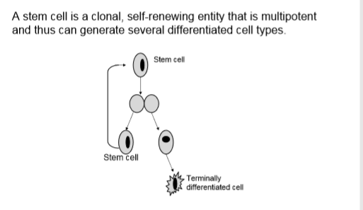

Slide 3
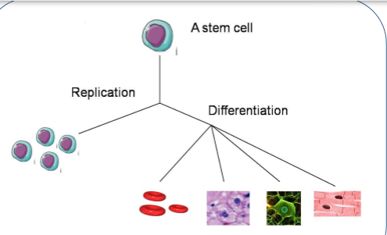
Characteristics of Stem cells: Replication and Differentiation

Slide 4
They are vital to the development, growth, maintenance, and repair of our brains
bones, muscles, nerves, blood, skin, and other organs.
Classification of stem cells on the basis of potency Stem cells can be classified by the extent to which they can differentiate into different cell types.
These four main classifications are totipotent, pluripotent, multipotent, or unipotent
Totipotent The ability to differentiate into all possible cell types
Examples are the zygote formed at egg fertilization can give rise to entire organism
Pluripotent The ability to differentiate into almost all cell types. Examples include embryonic stem cells and cells that are derived from the mesoderm, endoderm, and
ectoderm germ layers that are formed in the beginning stages of embryonic stem cell differentiation.
Multipotent The ability to differentiate into a closely related family of cells. Examples include hematopoietic (adult) stem cells that can become red and white blood cells or platelets.

Slide 5
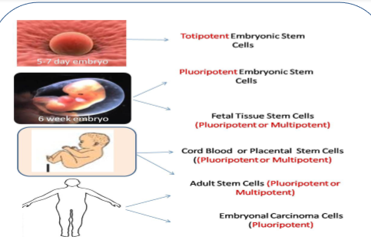
Classification of stem cells based on their Potency

Slide 6

Oligopotent The ability to differentiate into a few cells. Examples include (adult) lymphoid or myeloid stem cells.
Unipotent The ability to only produce cells of their own type, but have the property of selfrenewal required to be labeled a stem cell. Examples include (adult) muscle stem cells ( Satellite / sat cells.

Slide 7
Classification of stem cells on the basis of their sources.
The easiest way to categorize stem cells is by dividing them into two types: Early or embryonic and mature or adult. Early stem cells, often called embryonic stem cells, are found in the inner cell mass of a blastocyst after approximately five days of development.
Mature stem cells are found in specific mature body tissues as well as the umbilical cord and placenta after birth.
Embryonic stem cells Embryonic stem cells are self-replicating pluripotent cells that are potentially immortal.
They are derived from embryos at a developmental stage before the time of implantation would normally occur in the uterus.
The embryos from which human embryonic stem cells are derived are typically four or five days old and are a hollow microscopic ball of cells called the blastocyst.

Slide 8
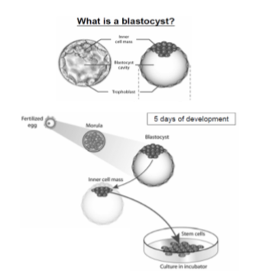

Slide 9
Adult stem cells are undifferentiated totipotent or multipotent cells, found throughout the body after embryonic development, that multiply by cell division to replenish dying cells and regenerate damaged tissues.
The primary roles of adult stem cells in a living organism are to maintain and repair the tissue in which they are found. Unlike embryonic stem cells, which are defined by their origin (the inner cell mass of the blastocyst), the origin of adult stem cells in some mature tissues is still under investigation.
Induced Pluripotent stem cells, a third type of stem cell, with properties similar to embryonic stem cells, has emerged. Scientists have engineered these induced pluripotent stem cellsi (iPS cells) by manipulating the expression of certain genes - 'reprogramming' somatic cells back to a pluripotent state.

Slide 10
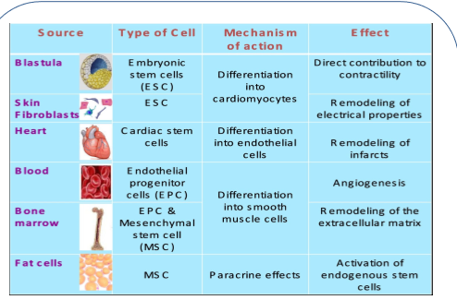
Sources of Stem cells

Slide 11
Stem cell culture Growing cells in the laboratory is known as cell culture. Human embryonic stem cells (hESCs) are generated by transferring cells from a preimplantationstage embryo into a plastic laboratory culture dish that contains a nutrient broth known as culture medium.
The cells divide and spread over the surface of the dish. However, if the plated cells survive, divide and multiply enough to crowd the dish, they are removed gently and plated into several fresh culture dishes.
The process of replating or sub culturing the cells is repeated many times and for many months.
Each cycle of subculturing / passaging the cells is referred to as a passage. Once the cell line is established, the original cells yield millions of embryonic stem cells . Embryonic stem cells that have proliferated in cell culture for six or more months without
differentiating, are pluripotent, and appear genetically normal are referred to as an embryonic stem cell line. At any stage in the process, batches of cells can be frozen and shipped to other laboratories for further culture and experimentation.

Slide 12
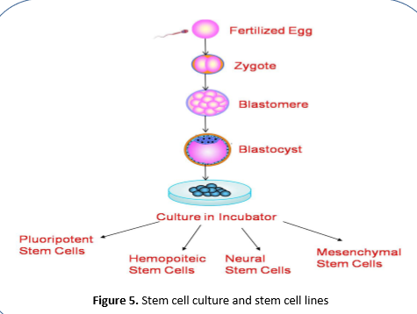
Stem cell culture and stem cell lines

Slide 13
Stem cell lines
A stem cell line is a family of constantly dividing cells, the product of a single parent group of stem cells. They are obtained from human or animal tissues and can replicate for long periods of time in vitro ("within glass"; or, commonly, "in the lab", in an artificial environment).
They are frequently used for research relating to embryonic stem cells or cloning entire organism .
Once stem cells have been allowed to divide and propagate in a controlled culture, the collection of healthy, dividing, and undifferentiated cells is called a stem cell line.

Slide 14
Applications
A number of stem cell therapeutics exist, but most are at experimental stages with the notable exception of bone marrow transplantation .
Few adult and embryonic stem cells to treat cancer, Type 1 diabetes mellitus, Parkinson's disease, Huntington's disease is underway.
Bone marrow transplants (BMT) are a well known clinical application of stem cell transplantation. BMT can repopulate the marrow and restore all the different cell types of the blood after high doses of chemotherapy and/or radiotherapy, our main defense used to eliminate endogenous cancer cells. The isolation of additional stem and progenitors cells is now being developed for many other clinical applications.
Skin replacement : Skin (keratinocyte) stem cells reside in the hair follicle and can be removed when a hair is plucked. These cells can be cultured to form an epidermal equivalent of the patients own skin and provides tissue for an autologous graft, bypassing the problem of rejection.

Slide 15
Brain cell transplantation : Stem cells can provide dopamine - a chemical lacking in victims of Parkinson’s disease. It involves the loss of cells which produce the neurotransmitter dopamine. The first double-blind study of fetal cell transplants for Parkinson’s disease reported survival and release of dopamine from the transplanted cells and a functional improvement of clinical symptoms. However, some patients developed side effects, which suggested that there was an over sensitization to or too much dopamine.
Treatment for diabetes: Diabetes affects millions of people in the world and is caused by the abnormal metabolism of insulin. Normally, insulin is produced and secreted by the cellular structures called the islets of langerhans in the pancreas. Recently, insulin expressing cells from mouse stem cells have been generated. In addition, the cells self assemble to form structures, which closely resemble normal pancreatic islets and produce insulin

Slide 16
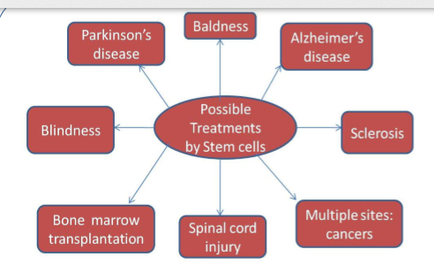
Applications of Stem cells

Slide 17
Kymriah (by Novartis) is the first therapy using engineered living cells to have been approved by the U.S. Food and Drug Administration. It is a treatment for B-cell acute lymphoblastic leukaemia (ALL), a cancer affecting the B lymphocytes (or B cells) of the immune system. B cells are the cells in the blood that make antibodies to help fight infections.
ALL is the most common type of cancer in children. Synthetic biology has been used to re-engineer the patient’s own cells to fight their cancer, which is remarkable.
The treatment involves isolating the patient’s T lymphocytes (or T cells) – these are the immune cells that detect infection – and genetically modifying these cells to express a chimeric antigen receptor (CAR). CAR is a fusion protein which includes an antibody that recognises CD19 protein, which is present on the malignant B cells.
The modified ‘CAR-T’ cells re-introduced into the patient are now able to recognise the cancer cells as malignant. CAR-T cells can then ensure that the cancerous B cells are targeted for destruction by the immune system. CAR-T cells can survive in the patient for years, if not decades, making them a very effective and specific therapy for treating ALL.

Slide 18
